Slide 1

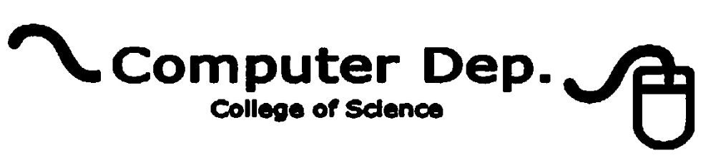
Discrete mathematics and its application
Lamya A. Omer
Lecture1 – part 1
2nd Stage
2020-2021
lamya.omer@uod.ac

Slide 2
Course Objectives
To present material in a precise, readable manner, with the concepts and techniques of discrete mathematics clearly presented and demonstrated related with computer sciences subjects.
To show the relevance and practicality of discrete mathematics to students, who are often skeptical. I wanted to give students studying computer science all of the mathematical foundations they need for their future studies

Slide 3
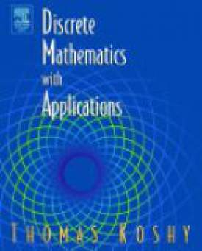
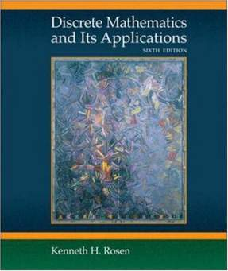
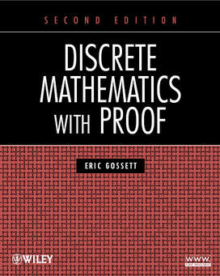
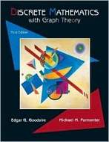
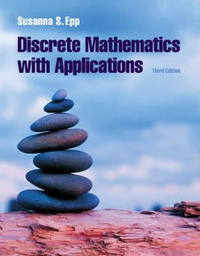
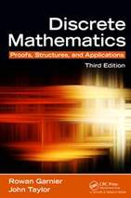
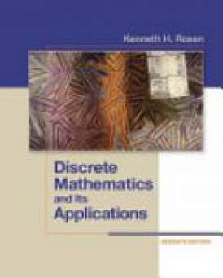

Slide 4
Evaluation
Homework: 10% (each assignment 5%)
Test Exam: 30% (each quiz 10%)
Final Exam: 30% as quiz
30% as report

Slide 5
What is Discrete Mathematics?
you learn continuous math. It deals with
continuous functions, differential and integral calculus.
In contrast, discrete math deals with mathematical topics in a sense that it analyzes data whose values are separated (such as integers: integer number line has gaps) Here is a very rough comparison between continuous math and
discrete math: consider an analog clock (one with hands that continuously rotate, which shows time in continuous fashion) vs. a digital clock (which shows time in discrete fashion).

Slide 6
What this course cover ?
Chapter 1- coverage of mathematical reasoning and proof is concentrated in chapter1 flowing from logic propositional and predicate logic to rules of inference to basic proof techniques to more advanced proof techniques and proof strategies .
Chapter2 – covers sets, functions
Chapter3 – covers number theory in two sections divisibility , and congruence’s in the first section while in the 2nd primes .
Chapter4 – covers the mathematical inductions and finally
chapter 5- covers series and the arithmetic and geometric sequences .

